Slide 1
South Central Region Update
Minor Markets Overview

Slide 2
New and improved Market Intelligence webcast series for 2026
U.S. & Macro Webcasts
Regional Webcasts
Specialty Webcasts
2025 Format (6)
4 U.S. updates/year
2 macroeconomic updates/year
2025 Format (32)
9 regions 4x/year
Carolinas, Deserts/Mountains, Florida, Midwest, Northeast/Mid-Atlantic, Southeast, Texas, West Coast
2025 Format (5)
2 research topics/year
3 student housing updates/year
New 2026 Format (7)
5 U.S. updates/year
2 macroeconomic updates/year
New 2026 Format (36)
9 regions 4x/year*
California, Florida, Midwest (East), Midwest (West), Northeast, Pacific & Mountain West, South Atlantic, South Central, Southeast
*9 regions will be split into “major” markets and “minor” markets. Major markets will have ~40 minute shows while minor markets will have ~15 minute shows.
(Refer to next slide for map)
New 2026 Format (11)
6 special research topics/year
3 industry trend topics/year
(new webcast mini-series)
2 student housing updates/year
Source: RealPage Market Analytics

Slide 3
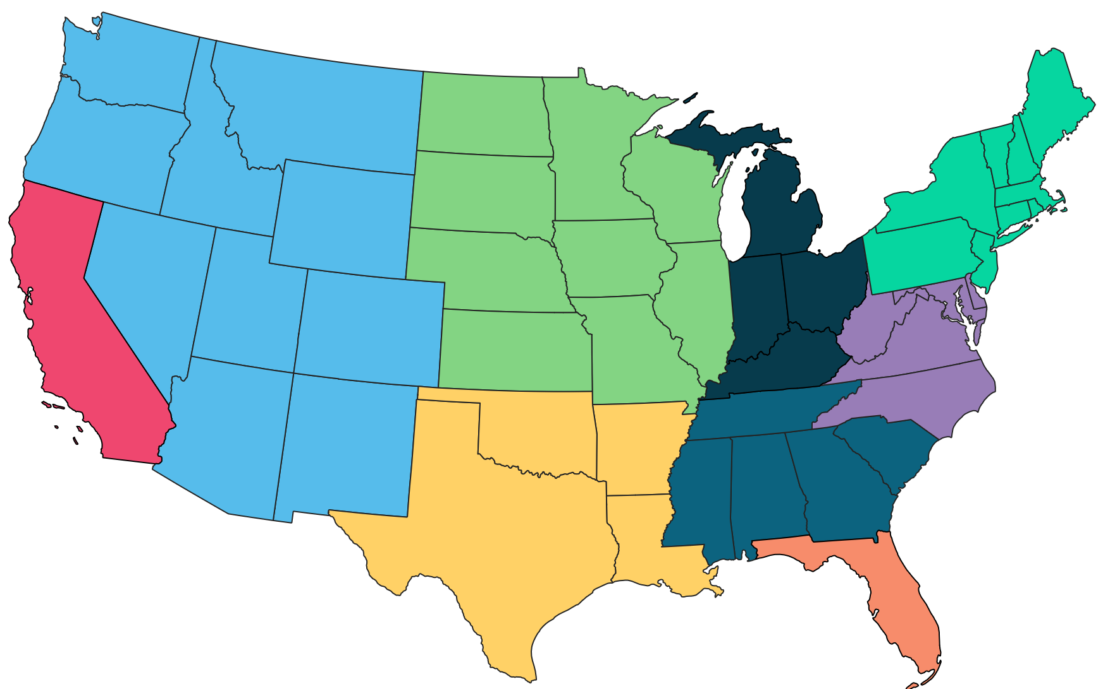
New and improved Market Intelligence webcast series regions for 2026
Midwest (West)
IA, IL, KS, MN, MO, ND, NE, SD, WI
Northeast
CT, MA, ME, NH, NJ, NY, PA, RI, VT
Pacific & Mountain West
AZ, CO, ID, MT, NM, NV, OR, UT, WA, WY
Midwest (East)
KY, IN, MI, OH
California
South Atlantic
D.C., DE, MD, NC, VA, WV
Southeast
AL, GA, MS, SC, TN
Note: Regions are RealPage-defined and may not overlap with other regional definitions from Census, BLS, etc.
South Central
AR, LA, OK, TX
Florida
Source: RealPage Market Analytics

Slide 4

South Central Region: Secondary/Tertiary (Minor) Metro Areas
Data as of 4Q25
South Central Region:
Secondary/Tertiary (Minor) Metro Areas
Gulf Coast Corridor
Baton Rouge, Beaumont, Corpus Christi, Lafayette, McAllen/Brownsville, New Orleans
Pineywoods & Prairies
Killeen, Shreveport, Tyler, Waco
West Texas
Abilene, Amarillo, El Paso, Lubbock, Midland/Odessa, San Angelo
Source: RealPage Market Analytics | Publicly Available Data

Slide 5
South Central Region: Secondary/Tertiary (Minor) Metro Areas
Data as of 4Q25
Gulf Coast Corridor Metros
Metro Area | Existing Units
Baton Rouge, LA | 52,325
Beaumont-Port Arthur, TX | 21,632
Corpus Christi, TX | 37,941
Lafayette/New Iberia, LA | 22,121
McAllen/Brownsville, TX | 38,996
New Orleans-Metairie/Slidell, LA | 83,568
Gulf Coast Corridor Avg. | 256,583
U.S. Average | 20.3m
Annual Supply / Demand
Supply | % Inventory Growth | Absorption
166 | 0.3% | 381
0 | 0.0% | 827
588 | 1.5% | 903
205 | 0.9% | 62
110 | 0.3% | 289
290 | 0.3% | -176
1,359 | 0.5% | 2,286
409k | 2.0% | 366k
Y/Y Change (Rents & Occupancy)
Effective Rent Change (Y/Y) | Occupancy | Occupancy Change (Y/Y)
-1.6% | 94.0% | 0.7%
4.7% | 95.5% | 3.8%
-2.5% | 93.4% | 1.0%
0.5% | 94.2% | -0.6%
1.6% | 93.1% | 0.5%
-1.6% | 94.7% | -0.5%
-0.5% | 93.8% | 0.3%
-0.6% | 94.8% | -0.1%
Source: RealPage Market Analytics | Publicly Available Data

Slide 6
South Central Region: Secondary/Tertiary (Minor) Metro Areas
Forecast as of January 2026
Gulf Coast Corridor Metros
Metro Area Forecast as of Jan. 2026 | 2026 Forecast
 | Supply | % Inventory Growth | Y/Y Effective Rent Chg. (Annual Avg.)
Baton Rouge, LA | 31 | 0.1% | 2.1%
Beaumont-Port Arthur, TX | 0 | 0.0% | 1.9%
Corpus Christi, TX | 344 | 0.9% | 0.3%
Lafayette/New Iberia, LA | 36 | 0.2% | 1.3%
McAllen/Brownsville, TX | 26 | 0.1% | 1.6%
New Orleans-Metairie/Slidell, LA | 0 | 0.0% | 1.2%
Gulf Coast Corridor Avg. | 437 | 0.2% | 1.4%
U.S. Average | 317k | 1.6% | 1.9%
Source: RealPage Market Analytics | Publicly Available Data

Slide 7
South Central Region: Secondary/Tertiary (Minor) Metro Areas
Data as of 4Q25
Pineywoods & Prairies Metros
Metro Area | Existing Units
Killeen-Temple, TX | 22,561
Shreveport-Bossier City/Minden, LA | 26,218
Tyler, TX | 11,005
Waco, TX | 18,997
Pineywoods & Prairies Avg. | 78,781
U.S. Average | 20.3m
Annual Supply / Demand
Supply | % Inventory Growth | Absorption
108 | 0.5% | -315
0 | 0.0% | 407
12 | 0.1% | 104
9 | 0.0% | -267
129 | 0.2% | -71
409k | 2.0% | 366k
Y/Y Change (Rents & Occupancy)
Effective Rent Change (Y/Y) | Occupancy | Occupancy Change (Y/Y)
-3.3% | 91.7% | -1.9%
2.7% | 95.7% | 1.6%
-1.5% | 95.5% | 0.8%
-3.0% | 94.0% | -1.3%
-1.0% | 92.2% | -1.3%
-0.6% | 94.8% | -0.1%
Source: RealPage Market Analytics | Publicly Available Data

Slide 8
South Central Region: Secondary/Tertiary (Minor) Metro Areas
Forecast as of January 2026
Pineywoods & Prairies Metros
Metro Area Forecast as of Jan. 2026 | 2026 Forecast
 | Supply | % Inventory Growth | Y/Y Effective Rent Chg. (Annual Avg.)
Killeen-Temple, TX | 0 | 0.0% | 2.2%
Shreveport-Bossier City/Minden, LA | 88 | 0.3% | 3.4%
Tyler, TX | 28 | 0.3% | 2.6%
Waco, TX | 0 | 0.0% | 1.7%
Pineywoods & Prairies Avg. | 116 | 0.1% | 2.5%
U.S. Average | 317k | 1.6% | 1.9%
Source: RealPage Market Analytics | Publicly Available Data

Slide 9
South Central Region: Secondary/Tertiary (Minor) Metro Areas
Data as of 4Q25
West Texas Metros
Metro Area | Existing Units
Abilene, TX | 9,017
Amarillo, TX | 16,405
El Paso, TX | 55,989
Lubbock, TX | 26,769
Midland/Odessa, TX | 27,290
San Angelo, TX | 8,560
West Texas Avg. | 144,030
U.S. Average | 20.3m
Annual Supply / Demand
Supply | % Inventory Growth | Absorption
0 | 0.0% | 362
0 | 0.0% | 374
30 | 0.1% | 117
0 | 0.0% | 215
0 | 0.0% | 115
0 | 0.0% | 255
30 | 0.0% | 1,438
409k | 2.0% | 366k
Y/Y Change (Rents & Occupancy)
Effective Rent Change (Y/Y) | Occupancy | Occupancy Change (Y/Y)
20.3% | 99.0% | 4.0%
4.3% | 97.2% | 2.3%
0.8% | 95.9% | 0.2%
1.9% | 94.2% | 0.8%
-0.9% | 93.2% | 0.4%
-0.5% | 96.2% | 3.0%
2.2% | 95.4% | 0.0%
-0.6% | 94.8% | -0.1%
Source: RealPage Market Analytics | Publicly Available Data

Slide 10
South Central Region: Secondary/Tertiary (Minor) Metro Areas
Forecast as of January 2026
West Texas Metros
Metro Area Forecast as of Jan. 2026 | 2026 Forecast
 | Supply | % Inventory Growth | Y/Y Effective Rent Chg. (Annual Avg.)
Abilene, TX | 0 | 0.0% | 5.2%
Amarillo, TX | 466 | 2.8% | 1.7%
El Paso, TX | 150 | 0.3% | 2.1%
Lubbock, TX | 0 | 0.0% | 2.5%
Midland/Odessa, TX | 0 | 0.0% | 2.7%
San Angelo, TX | 0 | 0.0% | 3.3%
West Texas Avg. | 616 | 0.4% | 2.5%
U.S. Average | 317k | 1.6% | 1.9%
Source: RealPage Market Analytics | Publicly Available Data

Slide 11
Q&A + Appendix slides

