Slide 1
Florida Region Update Minor Markets Overview

Slide 2
New and improved Market Intelligence webcast series for 2026
U.S. & Macro Webcasts
Regional Webcasts
Specialty Webcasts
2025 Format (6)
4 U.S. updates/year
2 macroeconomic updates/year
2025 Format (32)
9 regions 4x/year
Carolinas, Deserts/Mountains, Florida, Midwest, Northeast/Mid-Atlantic, Southeast, Texas, West Coast
2025 Format (5)
2 research topics/year
3 student housing updates/year
New 2026 Format (7)
5 U.S. updates/year
2 macroeconomic updates/year
New 2026 Format (36)
9 regions 4x/year*
California, Florida, Midwest (East), Midwest (West), Northeast, Pacific & Mountain West, South Atlantic, South Central, Southeast
*9 regions will be split into “major” markets and “minor” markets. Major markets will have ~40 minute shows while minor markets will have ~15 minute shows.
(Refer to next slide for map)
New 2026 Format (11)
6 special research topics/year
3 industry trend topics/year
(new webcast mini-series)
2 student housing updates/year
Source: RealPage Market Analytics

Slide 3
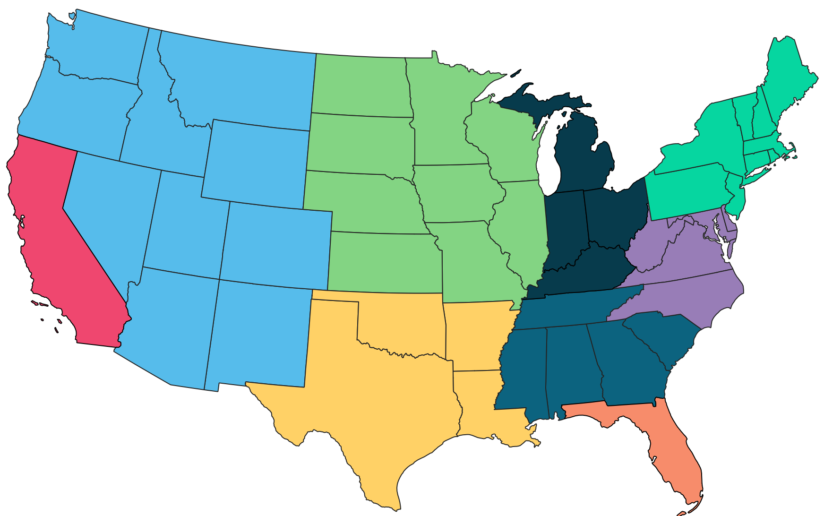
New and improved Market Intelligence webcast series regions for 2026
Midwest (West)
IA, IL, KS, MN, MO, ND, NE, SD, WI
Northeast
CT, MA, ME, NH, NJ, NY, PA, RI, VT
Pacific & Mountain West
AZ, CO, ID, MT, NM, NV, OR, UT, WA, WY
Midwest (East)
KY, IN, MI, OH
California
South Atlantic
D.C., DE, MD, NC, VA, WV
Southeast
AL, GA, MS, SC, TN
Note: Regions are RealPage-defined and may not overlap with other regional definitions from Census, BLS, etc.
South Central
AR, LA, OK, TX
Florida
Source: RealPage Market Analytics

Slide 4

Florida Region:
Secondary/Tertiary (Minor) Metro Areas
Florida Core
Gainesville, Lakeland, Tallahassee
Florida Panhandle
Destin (Crestview), Panama City, Pensacola
Florida Shore
Deltona-Daytona Beach, Naples, Palm Bay, Port St. Lucie
Source: RealPage Market Analytics | Publicly Available Data

Slide 5
Florida Region: Secondary/Tertiary (Minor) Metro Areas
Data as of 4Q25
Florida Core Metros
Metro Area | Existing Units
Gainesville, FL | 31,174
Lakeland, FL | 37,589
Tallahassee, FL | 32,123
Florida Core Avg. | 100,886
U.S. Average | 20.3m
Annual Supply / Demand
Supply | % Inventory Growth | Absorption
401 | 1.3% | 731
1,420 | 3.9% | 1,559
340 | 0.9% | 680
2,161 | 2.1% | 2,970
409k | 2.0% | 366k
Y/Y Change (Rents & Occupancy)
Effective Rent Change (Y/Y) | Occupancy | Occupancy Change (Y/Y)
1.7% | 94.3% | 1.2%
0.4% | 94.1% | 0.6%
-0.1% | 94.5% | 1.3%
0.7% | 94.3% | 1.0%
-0.6% | 94.8% | -0.1%
Source: RealPage Market Analytics | Publicly Available Data

Slide 6
Florida Region: Secondary/Tertiary (Minor) Metro Areas
Forecast as of January 2026
Florida Core Metros
Metro Area Forecast as of Jan. 2026 | 2026 Forecast
 | Supply | % Inventory Growth | Y/Y Effective Rent Chg. (Annual Avg.)
Gainesville, FL | 480 | 1.5% | 1.8%
Lakeland, FL | 1,500 | 4.0% | 2.0%
Tallahassee, FL | 660 | 2.1% | 1.3%
Florida Core Avg. | 2,640 | 2.6% | 1.7%
U.S. Average | 317k | 1.6% | 1.9%
Source: RealPage Market Analytics | Publicly Available Data

Slide 7
Florida Region: Secondary/Tertiary (Minor) Metro Areas
Data as of 4Q25
Florida Panhandle Metros
Metro Area | Existing Units
Crestview (Destin), FL | 27,174
Panama City, FL | 22,684
Pensacola, FL | 29,069
Florida Panhandle Avg. | 78,927
U.S. Average | 20.3m
Annual Supply / Demand
Supply | % Inventory Growth | Absorption
1,685 | 6.6% | 1,582
343 | 1.5% | 200
852 | 3.0% | 974
2,881 | 3.8% | 2,756
409k | 2.0% | 366k
Y/Y Change (Rents & Occupancy)
Effective Rent Change (Y/Y) | Occupancy | Occupancy Change (Y/Y)
-7.0% | 92.5% | 0.1%
-2.8% | 93.7% | -0.5%
-0.3% | 94.3% | 0.6%
-3.3% | 93.5% | 0.1%
-0.6% | 94.8% | -0.1%
Source: RealPage Market Analytics | Publicly Available Data

Slide 8
Florida Region: Secondary/Tertiary (Minor) Metro Areas
Forecast as of January 2026
Florida Panhandle Metros
Metro Area Forecast as of Jan. 2026 | 2026 Forecast
 | Supply | % Inventory Growth | Y/Y Effective Rent Chg. (Annual Avg.)
Crestview (Destin), FL | 832 | 3.1% | -2.9%
Panama City, FL | 229 | 1.0% | -0.8%
Pensacola, FL | 816 | 2.8% | 0.8%
Florida Panhandle Avg. | 1,877 | 2.4% | -1.0%
U.S. Average | 317k | 1.6% | 1.9%
Source: RealPage Market Analytics | Publicly Available Data

Slide 9
Florida Region: Secondary/Tertiary (Minor) Metro Areas
Data as of 4Q25
Florida Shore Metros
Metro Area | Existing Units
Deltona, FL | 42,711
Naples, FL | 34,251
Palm Bay, FL | 44,205
Port St. Lucie, FL | 32,663
Florida Shore Avg. | 153,830
U.S. Average | 20.3m
Annual Supply / Demand
Supply | % Inventory Growth | Absorption
1,865 | 4.6% | 1,713
1,196 | 3.4% | 567
1,081 | 2.5% | 1,341
740 | 2.3% | 826
4,882 | 3.2% | 4,456
409k | 2.0% | 366k
Y/Y Change (Rents & Occupancy)
Effective Rent Change (Y/Y) | Occupancy | Occupancy Change (Y/Y)
-4.1% | 94.3% | -0.1%
-10.3% | 93.6% | -1.4%
-1.7% | 94.3% | 0.8%
-1.4% | 93.8% | 0.4%
-4.2% | 94.0% | 0.0%
-0.6% | 94.8% | -0.1%
Source: RealPage Market Analytics | Publicly Available Data

Slide 10
Florida Region: Secondary/Tertiary (Minor) Metro Areas
Forecast as of January 2026
Florida Shore Metros
Metro Area Forecast as of Jan. 2026 | 2026 Forecast
 | Supply | % Inventory Growth | Y/Y Effective Rent Chg. (Annual Avg.)
Deltona, FL | 1,435 | 3.4% | -1.9%
Naples, FL | 872 | 2.6% | -2.6%
Palm Bay, FL | 1,598 | 3.6% | -0.1%
Port St. Lucie, FL | 444 | 1.4% | 0.9%
Florida Shore Avg. | 4,349 | 2.9% | -0.9%
U.S. Average | 317k | 1.6% | 1.9%
Source: RealPage Market Analytics | Publicly Available Data

Slide 11
Q&A + Appendix slides

