Slide 1
Upper Midwest/Great Plains Region Update
Minor Markets Overview

Slide 2
New and improved Market Intelligence webcast series for 2026
U.S. & Macro Webcasts
Regional Webcasts
Specialty Webcasts
2025 Format (6)
4 U.S. updates/year
2 macroeconomic updates/year
2025 Format (32)
9 regions 4x/year
Carolinas, Deserts/Mountains, Florida, Midwest, Northeast/Mid-Atlantic, Southeast, Texas, West Coast
2025 Format (5)
2 research topics/year
3 student housing updates/year
New 2026 Format (7)
5 U.S. updates/year
2 macroeconomic updates/year
New 2026 Format (36)
9 regions 4x/year*
California, Florida, Midwest (East), Midwest (West), Northeast, Pacific & Mountain West, South Atlantic, South Central, Southeast
*9 regions will be split into “major” markets and “minor” markets. Major markets will have ~40 minute shows while minor markets will have ~15 minute shows.
(Refer to next slide for map)
New 2026 Format (11)
6 special research topics/year
3 industry trend topics/year
(new webcast mini-series)
2 student housing updates/year
Source: RealPage Market Analytics

Slide 3
New and improved Market Intelligence webcast series regions for 2026
Upper Midwest/Great Plains
IA, IL, KS, MN, MO, ND, NE, SD, WI
Northeast
CT, MA, ME, NH, NJ, NY, PA, RI, VT
Pacific & Mountain West
AZ, CO, ID, MT, NM, NV, OR, UT, WA, WY
Great Lakes/Ohio Valley
KY, IN, MI, OH
California
South Atlantic
D.C., DE, MD, NC, VA, WV
Southeast
AL, GA, MS, SC, TN
Note: Regions are RealPage-defined and may not overlap with other regional definitions from Census, BLS, etc.
South Central
AR, LA, OK, TX
Florida
Source: RealPage Market Analytics

Slide 4
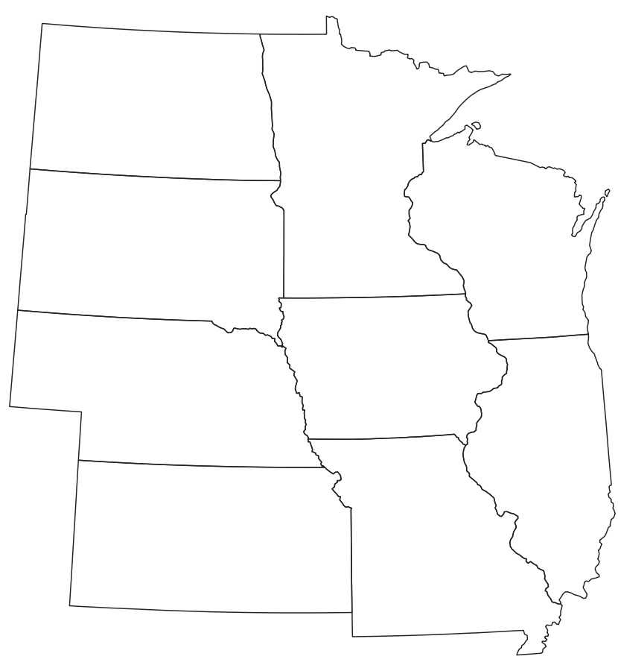
Upper Midwest/Great Plains Region:
Secondary/Tertiary (Minor) Metro Areas
Great Plains Markets
Fargo, Lawrence, Lincoln, Sioux Falls, Wichita
Heartland Markets
Champaign/Urbana, Davenport, Springfield (MO)
Source: RealPage Market Analytics | Publicly Available Data

Slide 5
Upper Midwest/Great Plains: Secondary/Tertiary (Minor) Metro Areas
Data as of 1Q26
Great Plains Metros
Metro Area 1Q26 Actuals | Existing Units
Fargo, ND | 39,228
Lawrence, KS | 13,347
Lincoln, NE | 36,748
Sioux Falls, SD | 32,398
Wichita, KS | 39,583
Plains Avg. | 161,304
U.S. Average | 20.3m
Annual Supply / Demand
Supply | % Inventory Growth | Absorption
163 | 0.4% | 296
0 | 0.0% | -148
869 | 2.4% | 555
1,845 | 6.0% | 2,353
751 | 1.9% | 1,146
3,628 | 2.3% | 4,202
367K | 1.8% | 303K
Y/Y Change (Rents & Occupancy)
Effective Rent Change (Y/Y) | Occupancy | Occupancy Change (Y/Y)
2.4% | 94.9% | 0.4%
3.5% | 97.2% | -1.1%
2.2% | 94.2% | -0.7%
0.2% | 94.4% | 2.0%
4.6% | 95.2% | 1.1%
3.0% | 94.9% | 0.6%
-0.5% | 94.9% | -0.2%
Source: RealPage Market Analytics | Publicly Available Data

Slide 6
Upper Midwest/Great Plains: Secondary/Tertiary (Minor) Metro Areas
Forecast as of April 2026
Great Plains Metros
Metro Area Forecast as of Apr. 2026 | 2026 Forecast
 | Supply | % Inventory Growth | Y/Y Effective Rent Chg. (Annual Avg.)
Fargo, ND | 196 | 0.5% | 3.1%
Lawrence, KS | 0 | 0.0% | 2.7%
Lincoln, NE | 496 | 1.4% | 3.0%
Sioux Falls, SD | 420 | 1.3% | 2.0%
Wichita, KS | 347 | 0.9% | 3.4%
Plains Avg. | 1,459 | 0.9% | 3.0%
U.S. Average | 310K | 1.5% | 0.7%
Source: RealPage Market Analytics | Publicly Available Data

Slide 7
Upper Midwest/Great Plains: Secondary/Tertiary (Minor) Metro Areas
Data as of 1Q26
Heartland Metros
Metro Area 1Q26 Actuals | Existing Units
Champaign-Urbana, IL | 27,680
Davenport, IA | 22,829
Springfield, MO | 25,856
Heartland Avg. | 76,365
U.S. Average | 20.3m
Annual Supply / Demand
Supply | % Inventory Growth | Absorption
168 | 0.5% | 134
448 | 1.7% | 771
317 | 0.9% | 230
933 | 1.2% | 1,135
367K | 1.8% | 303K
Y/Y Change (Rents & Occupancy)
Effective Rent Change (Y/Y) | Occupancy | Occupancy Change (Y/Y)
5.8% | 97.2% | 0.0%
0.5% | 96.7% | 1.8%
2.0% | 96.4% | 0.1%
2.4% | 96.7% | 0.6%
-0.5% | 94.9% | -0.2%
Source: RealPage Market Analytics | Publicly Available Data

Slide 8
Upper Midwest/Great Plains: Secondary/Tertiary (Minor) Metro Areas
Forecast as of April 2026
Heartland Metros
Metro Area Forecast as of Apr. 2026 | 2026 Forecast
 | Supply | % Inventory Growth | Y/Y Effective Rent Chg. (Annual Avg.)
Champaign-Urbana, IL | 0 | 0.0% | 4.1%
Davenport, IA | 117 | 0.5% | 1.4%
Springfield, MO | 658 | 2.6% | 3.2%
Heartland Avg. | 775 | 1.0% | 2.8%
U.S. Average | 310K | 1.5% | 0.7%
Source: RealPage Market Analytics | Publicly Available Data

Slide 9
Q&A + Appendix slides

