Slide 1
Pacific & Mountain West Region Update
Minor Markets Overview

Slide 2
New and improved Market Intelligence webcast series for 2026
U.S. & Macro Webcasts
Regional Webcasts
Specialty Webcasts
2025 Format (6)
4 U.S. updates/year
2 macroeconomic updates/year
2025 Format (32)
9 regions 4x/year
Carolinas, Deserts/Mountains, Florida, Midwest, Northeast/Mid-Atlantic, Southeast, Texas, West Coast
2025 Format (5)
2 research topics/year
3 student housing updates/year
New 2026 Format (7)
5 U.S. updates/year
2 macroeconomic updates/year
New 2026 Format (36)
9 regions 4x/year*
California, Florida, Midwest (East), Midwest (West), Northeast, Pacific & Mountain West, South Atlantic, South Central, Southeast
*9 regions will be split into “major” markets and “minor” markets. Major markets will have ~40 minute shows while minor markets will have ~15 minute shows.
(Refer to next slide for map)
New 2026 Format (11)
6 special research topics/year
3 industry trend topics/year
(new webcast mini-series)
2 student housing updates/year
Source: RealPage Market Analytics

Slide 3
New and improved Market Intelligence webcast series regions for 2026
Upper Midwest/Great Plains
IA, IL, KS, MN, MO, ND, NE, SD, WI
Northeast
CT, MA, ME, NH, NJ, NY, PA, RI, VT
Pacific & Mountain West
AZ, CO, ID, MT, NM, NV, OR, UT, WA, WY
Great Lake/Ohio Valley
KY, IN, MI, OH
California
South Atlantic
D.C., DE, MD, NC, VA, WV
Southeast
AL, GA, MS, SC, TN
Note: Regions are RealPage-defined and may not overlap with other regional definitions from Census, BLS, etc.
South Central
AR, LA, OK, TX
Florida
Source: RealPage Market Analytics

Slide 4
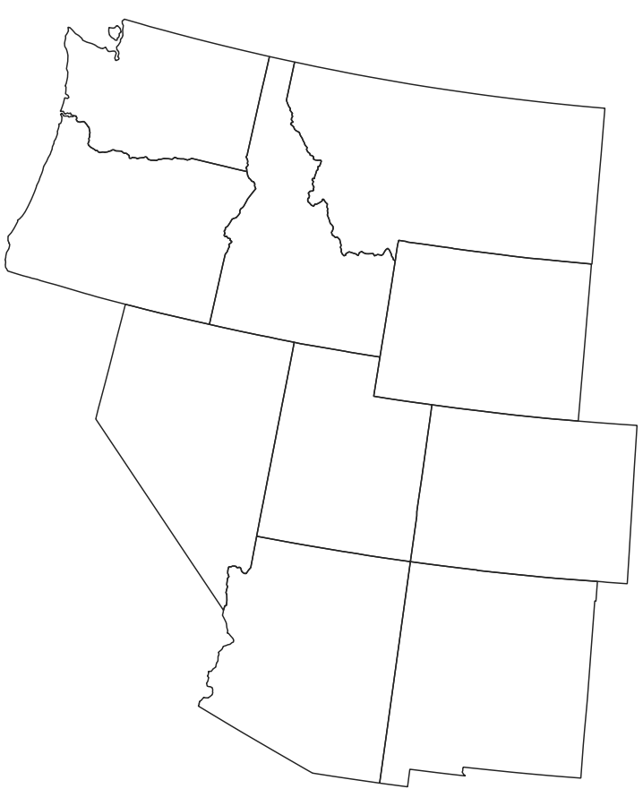

Pacific & Mountain West Region:
Secondary/Tertiary (Minor) Metro Areas
Mountain West
Boise, Boulder, Fort Collins, Greeley, Provo
Pacific Northwest
Eugene, Kennewick, Olympia, Salem, Spokane, Urban Honolulu
Source: RealPage Market Analytics | Publicly Available Data

Slide 5
Pacific & Mountain West Region: Secondary/Tertiary (Minor) Metro Areas
Data as of 1Q26
Mountain West Region Metros
Metro Area | Existing Units | Annual Supply / Demand |  |  | Y/Y Change (Rents & Occupancy)
 |  | Supply | % Inventory Growth | Absorption | Effective Rent Change (Y/Y) | Occupancy | Occupancy Change (Y/Y)
Boise City, ID | 39,489 | 1,209 | 3.2% | 1,219 | 2.0% | 95.0% | 0.2%
Boulder, CO | 32,738 | 820 | 2.6% | 769 | -5.6% | 94.8% | 0.0%
Fort Collins, CO | 24,713 | 484 | 2.0% | 306 | -0.1% | 94.3% | -0.6%
Greeley, CO | 20,920 | 708 | 3.5% | 378 | -2.7% | 93.6% | -1.4%
Provo, UT | 30,531 | 1,221 | 4.2% | 1,473 | -0.4% | 95.5% | 1.1%
Mountain West | 123,678 | 3,958 | 3.3% | 3,839 | -1.1% | 94.8% | 0.0%
U.S. Average | 20.3m | 367K | 1.8% | 303K | -0.5% | 94.9% | -0.2%
Source: RealPage Market Analytics | Publicly Available Data

Slide 6
Pacific & Mountain West Region: Secondary/Tertiary (Minor) Metro Areas
Forecast as of April 2026
Mountain West Region Metros
Metro Area Forecast as of Apr. 2026 | 2026 Forecast
 | Supply | % Inventory Growth | Y/Y Effective Rent Chg. (Annual Avg.)
Boise City, ID | 575 | 1.5% | 3.2%
Boulder, CO | 774 | 2.4% | -2.1%
Fort Collins, CO | 0 | 0.0% | 0.0%
Greeley, CO | 728 | 3.5% | 0.5%
Provo, UT | 532 | 1.8% | 1.1%
Mountain West | 2,609 | 2.1% | 1.0%
U.S. Average | 310K | 1.5% | 0.7%
Source: RealPage Market Analytics | Publicly Available Data

Slide 7
Pacific & Mountain West Region: Secondary/Tertiary (Minor) Metro Areas
Data as of 1Q26
Pacific Northwest Region Metros
Metro Area | Existing Units | Annual Supply / Demand |  |  | Y/Y Change (Rents & Occupancy)
 |  | Supply | % Inventory Growth | Absorption | Effective Rent Change (Y/Y) | Occupancy | Occupancy Change (Y/Y)
Eugene, OR | 26,465 | 298 | 0.8% | -64 | -0.6% | 94.3% | -1.0%
Kennewick, WA | 18,186 | 296 | 1.7% | 123 | -4.2% | 94.3% | -0.9%
Olympia, WA | 18,400 | 615 | 3.5% | 605 | 2.3% | 95.5% | 0.1%
Salem, OR | 28,326 | 555 | 2.0% | 272 | 1.3% | 94.3% | -0.9%
Spokane, WA | 46,400 | 647 | 1.4% | 992 | 1.0% | 95.4% | 0.8%
Urban Honolulu, HI | 82,688 | 0 | 0.0% | 422 | 7.1% | 97.3% | 0.5%
Pacific Northwest | 225,327 | 2,463 | 1.1% | 2,590 | 0.8% | 95.1% | -0.1%
U.S. Average | 20.3m | 367K | 1.8% | 303K | -0.5% | 94.9% | -0.2%
Source: RealPage Market Analytics | Publicly Available Data

Slide 8
Pacific & Mountain West Region: Secondary/Tertiary (Minor) Metro Areas
Forecast as of April 2026
Pacific Northwest Region Metros
Metro Area Forecast as of Apr. 2026 | 2026 Forecast
 | Supply | % Inventory Growth | Y/Y Effective Rent Chg. (Annual Avg.)
Eugene, OR | 440 | 1.1% | -0.9%
Kennewick, WA | 0 | 0.0% | 3.4%
Olympia, WA | 103 | 0.3% | 1.9%
Salem, OR | 60 | 0.1% | 2.8%
Spokane, WA | 0 | 0.0% | 2.0%
Urban Honolulu, HI | 60 | 0.1% | 2.8%
Pacific Northwest | 778 | 0.3% | 1.9%
U.S. Average | 310K | 1.5% | 0.7%
Source: RealPage Market Analytics | Publicly Available Data

Slide 9
Q&A + Appendix slides

